Slide 1
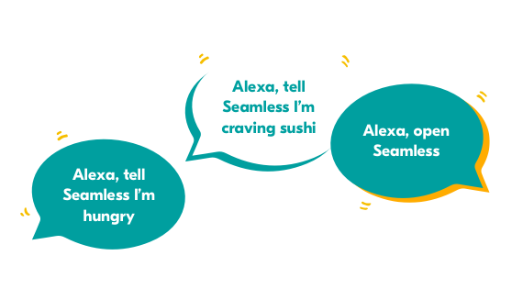




Amazon Alexa
Sonpari Tales Skill

Slide 2
Problem Statement
“Working parents are not able to teach their children proper values and ethics due to lack of time. Earlier, we had joint families and our grandparents used to tell us the stories in a good way. They were responsible for shaping the child's personality.”

Slide 3
Potential Value
Cultivate a personality
Strong moral values
Interactive UX
Vocabulary building
Indian Culture
Indian Touch

Slide 4
Proposed Flow
Greet
Check if user enabled skill today
Ask Question
Response (based on the question)
Tell Story with moral values
Mention to come tomorrow for new stories

Slide 5
Implementation
We have successfully built an Alexa Skill for proposed idea. It covers all the corner cases and does not gives error even if user stops skill at any point of.
It also tracks a record of last played story and its date and plays a new story only if it is not the current date is not equal to stored date

Slide 6


Slide 7
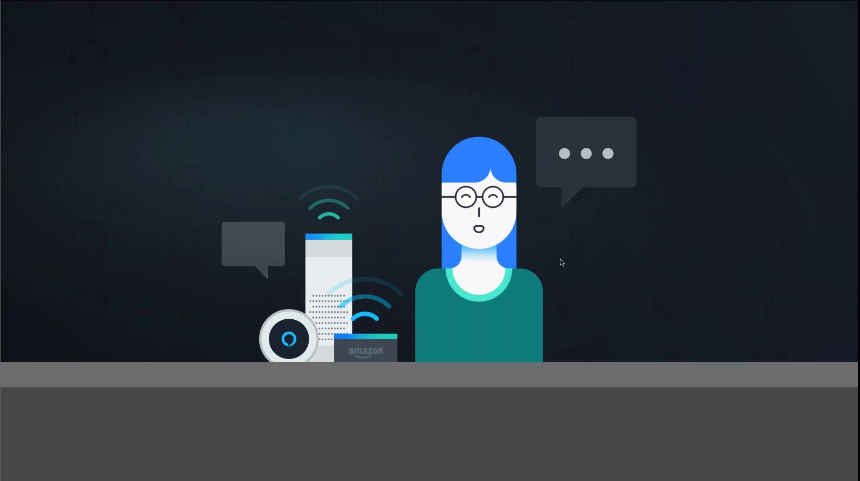
Thank You!

